Slide 1
Connecting Children’s Mathematical Thinking and Funds of Knowledge in Elementary Methods Courses
Corey Drake
Erin Turner
Alejandro Andreotti
Rodrigo J. Gutiérrez
Tonia Land

Slide 2
Acknowledgements
Julia Aguirre, Tonya Gau Bartell, Mary Foote, Elham Kazemi, Amy Roth McDuffie, Laura Spielman, Maura Varley
National Science Foundation (DRL #0736964)

Slide 3
Overview
Conference and participants
Goals and theoretical framework
Two examples of “extended learning activities”
Preliminary Results
Discussion

Slide 4
Conference
May, 2008, in Tucson, Arizona
38 participants from 19 institutions
Conceptual framework and readings, instructional module development, beginnings of research plan

Slide 5
Key Question
How can we connect children’s mathematical thinking and children’s community- and family-based mathematical funds of knowledge in elementary methods courses?

Slide 6
Goals of Conference (1)
To work towards the development of a conceptual framework for understanding the roles and relationships between children’s mathematical thinking and children’s cultural, linguistic, community, and family-based mathematical funds of knowledge in elementary mathematics methods courses

Slide 7
Goals of Conference (2)
To share current activities for introducing ideas about children’s mathematical thinking and children’s family, community, cultural, and linguistic funds of knowledge in elementary mathematics methods courses

Slide 8
Goals of Conference (3)
To develop or adapt “extended learning activities” (i.e., a set of readings, activities, materials, tasks, and discussion topics) for elementary mathematics methods courses

Slide 9
Theoretical Framework

Slide 10
Defining Pre-Service Teacher Learning As:
Engaging with the mathematical practices and identities of children and families as children move across contexts and spaces
Reflecting and acting on their own practices and identities as they move across contexts and spaces

Slide 11
Sample Activities

Slide 12
Activity Strands
Analysis of Critical Cases
Video cases of mathematics teaching/learning
Multi-level case studies of individual students
Mathematizing
Community Walks and Investigations
Children’s Stories and Everyday Activity

Slide 13
Video Cases
Pre-service teachers view video cases through one of three lenses (focus on the task, on the teacher, on student participation and understanding).
Analysis focuses on instructional strategies that facilitate mathematical thinking/reasoning and support students with varied cultural and linguistic backgrounds, mathematical experiences and competencies.

Slide 14
Cases Reflect Range of Teaching/Learning Settings
Sources include:
CGI (Cognitively Guided Instruction) books and professional development videotapes
Children’s Mathematics
Thinking Mathematically
Annenberg Media’s “Teaching Math K-4 Video Library” (available on-line)
Text-based Cases (i.e., chapters from Rethinking Mathematics text)

Slide 15
Sample Case: Almeta Hawkins
2nd grade, diverse urban elementary classroom
Whole class lesson on addition and subtraction problem solving
Part-Part Whole, Part Unknown Problem
“There are 47 trees in Logan Grove. 31 of them are oak trees. The rest are hickory. How many are hickory?”

Slide 16
Sample Case: Almeta Hawkins
Related reading/resources:
Carpenter, T., Fennema, E., Franke, M., Levi, L., & Empson, S. (1999). Children’s Mathematics: Cognitively Guided Instruction. Portsmouth, NH: Heinemann. Garrison, L., Ponce, G., and Amaral O. (2007, August). Ninety percent of the game is half mental. Teaching Children Mathematics.

Slide 17
Activity Overview
Review general discussion guidelines
Divide into small groups; each assigned one lens
View video clip
Individual reflection / small group discussion around lens prompts
Whole group debriefing (discussion, posters, etc.)

Slide 18
General Discussion Guide
Discussing the video:
Ground conversation in what you see in the video, talk about the children and teacher in the video rather than children or teachers in general.
Use examples from the video to ground your comments, questions, or claims.
Stay focused on the group’s questions.
Assume that students are making sense and that there is knowledge and expertise in what they are saying.

Slide 19
Three-lens Approach
Focus on Task
Focus on Student Learning and Participation
Focus on the Teacher
Notes:
At this point, participants are divided into groups, assigned a “lens” - distribute a set of prompts to each participant, ask them to read questions before video, then reflect in writing individually, then discuss with members of their group
HANDOUT NEEDED

Slide 20
Community Mathematizing Activity
Pre-service teachers explore local school and community contexts (parks, businesses, health centers, school playgrounds, etc.)
Activity includes in-class and out-of-class components
Community “walks”
Interviews with community members
Focused visits to observe, collect data, take pictures
Notes:
TIME: (total time for this part- 13/14 minutes)
Overview of activity and goals (slides 11, 12, 13): 2 minutes
Overview of different forms of activity (slides 14-19): 3-4 minutes
Examples: contexts investigated / questions asked (slides 20-22): 4 minutes
Examples: preservice teacher reflections (slides 23-25): 4 minutes

Slide 21
Community Mathematizing Activity: Goals
Recognize and begin to understand diverse mathematical practices in the school and local community.
Pose and investigate (mathematically) questions about contexts/situations in the school or local community.
Explicit focus on issues of equity and/or social justice
Expand ideas about the discipline and about themselves as mathematicians.
Think about ways to connect community funds of knowledge and children’s mathematical thinking.

Slide 22
Community Mathematizing Activity: Resources
For instructors:
Buck, P. & Sylvester, P.S. (2005) In N. Gonzalez, L. C. Moll & C. Amanti (Eds.), Funds of knowledge: Theorizing practices in households, communities, and classrooms (pp. 213-232). Mahway, NJ: Lawrence Erlbaum.
For Pre-service teachers:
Civil, M., & Kahn, L. (2001). Mathematics instruction developed from a garden theme Teaching Children Mathematics, 7(7), 400-405.

Slide 23
Overview of Activity: Option I
Option I: Community Walk
Phase I: Pre-Activity
Pre-service teachers reflect on their knowledge/experiences with the community, and discuss articles related to drawing on community-based funds of knowledge in mathematics instruction.

Slide 24
Overview of Activity: Option I
Phase II: Conduct community walk
Pre-service teachers conduct “community walk” in small groups, preferably with elementary students from their internship classroom. (Alternative is to ride bus home with students)
Opportunity for elementary students to share knowledge of community, particular focus on contexts/practices that student sees as mathematical.

Slide 25
Overview of Activity: Option I
Phase III: Develop Lessons/Activity
Pre-service teachers develop lesson(s) incorporating knowledge shared by elementary school students, and/or resources that were discussed or observed on the walk.
Phase IV: Directed Reflection

Slide 26
Overview of Activity: Option II
Option II: Community Investigations
Phase I: Brainstorming
Pre-service teachers brainstorm school or community contexts that could be investigated mathematically AND/OR that evidence mathematical activity.
Phase II: Initial Visits
LOOK for evidence of mathematics (i.e., mathematical practices, relationships, ideas etc.. ) Often involves talking with people, taking pictures, and making notes.
FORMULATE questions about the context. Involves generating questions that could be answered using mathematics and questions where the results might be useful or important to someone.

Slide 27
Overview of Activity: Option II
Phase III: Follow-up Visits
Pre-service teachers collect data to help answer questions. Data collection may involve talking to people at the site (interviewing employees, etc.., making observations, or collecting information).
Discuss and organize data. Decide how to represent the data (graph, table, chart, diagram, etc) to communicate findings to others.

Slide 28
Overview of Activity: Option II
Phase IV: Group Sharing / Debriefing
Pre-service teachers share questions they investigated, including a) why they chose the questions, and b) what data they generated.
Share Findings. Discuss what each representation shows and what additional questions it raises.
Discuss how to adapt the activity for elementary students, including how to draw on what they have learned about children’s mathematical thinking, and how to relate the activity to issues of equity and/or social justice in the school or community.

Slide 29
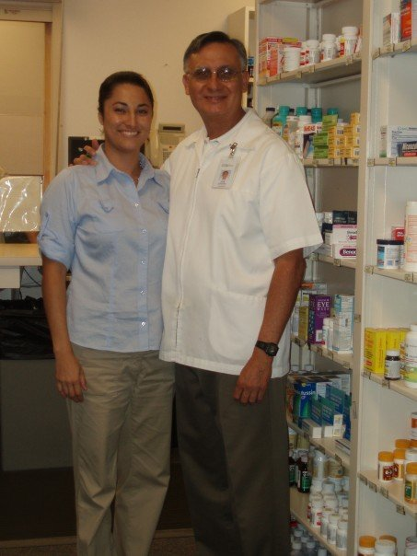
Examples
Community Health Center
Mathematics used to read and fill prescriptions, measure quantities, calculate payments
Question: How does the cost of prescription drugs differ for insured versus uninsured patients?
Notes:
Handout the chart that describes sample projects here

Slide 30
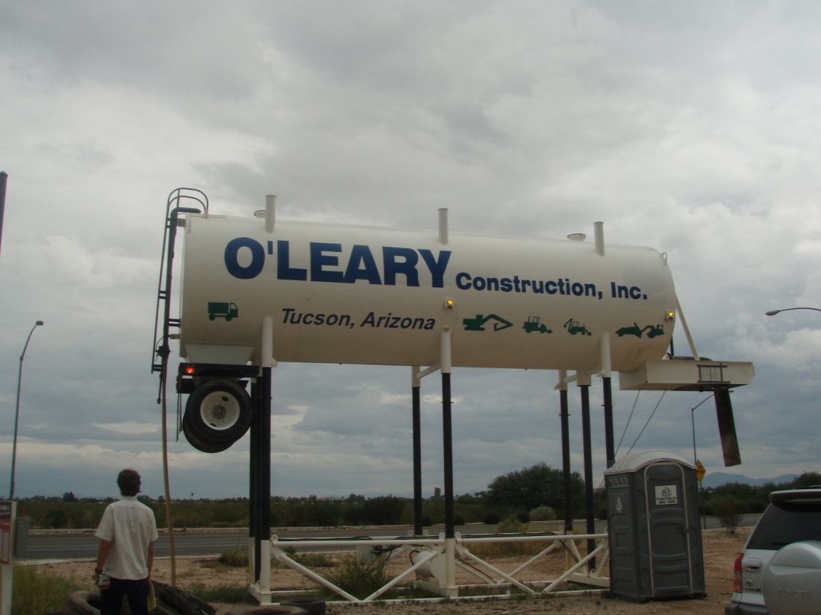
Construction Site next to School
Mathematics used in planning and constructing buildings, measurement (length, area, volume)
Questions: How much water does the site use a day if one tank lasts one week? How much water is used throughout the 6 month project? What would we have to do and for how long to use this much water?

Slide 31
Local Raspado Shop
Mathematics used in determining prices,measuring quantities, ordering supplies
Questions: Which size raspado is the best deal? What are the prices based on? How does the owner know when to reorder a particular flavor?

Slide 32
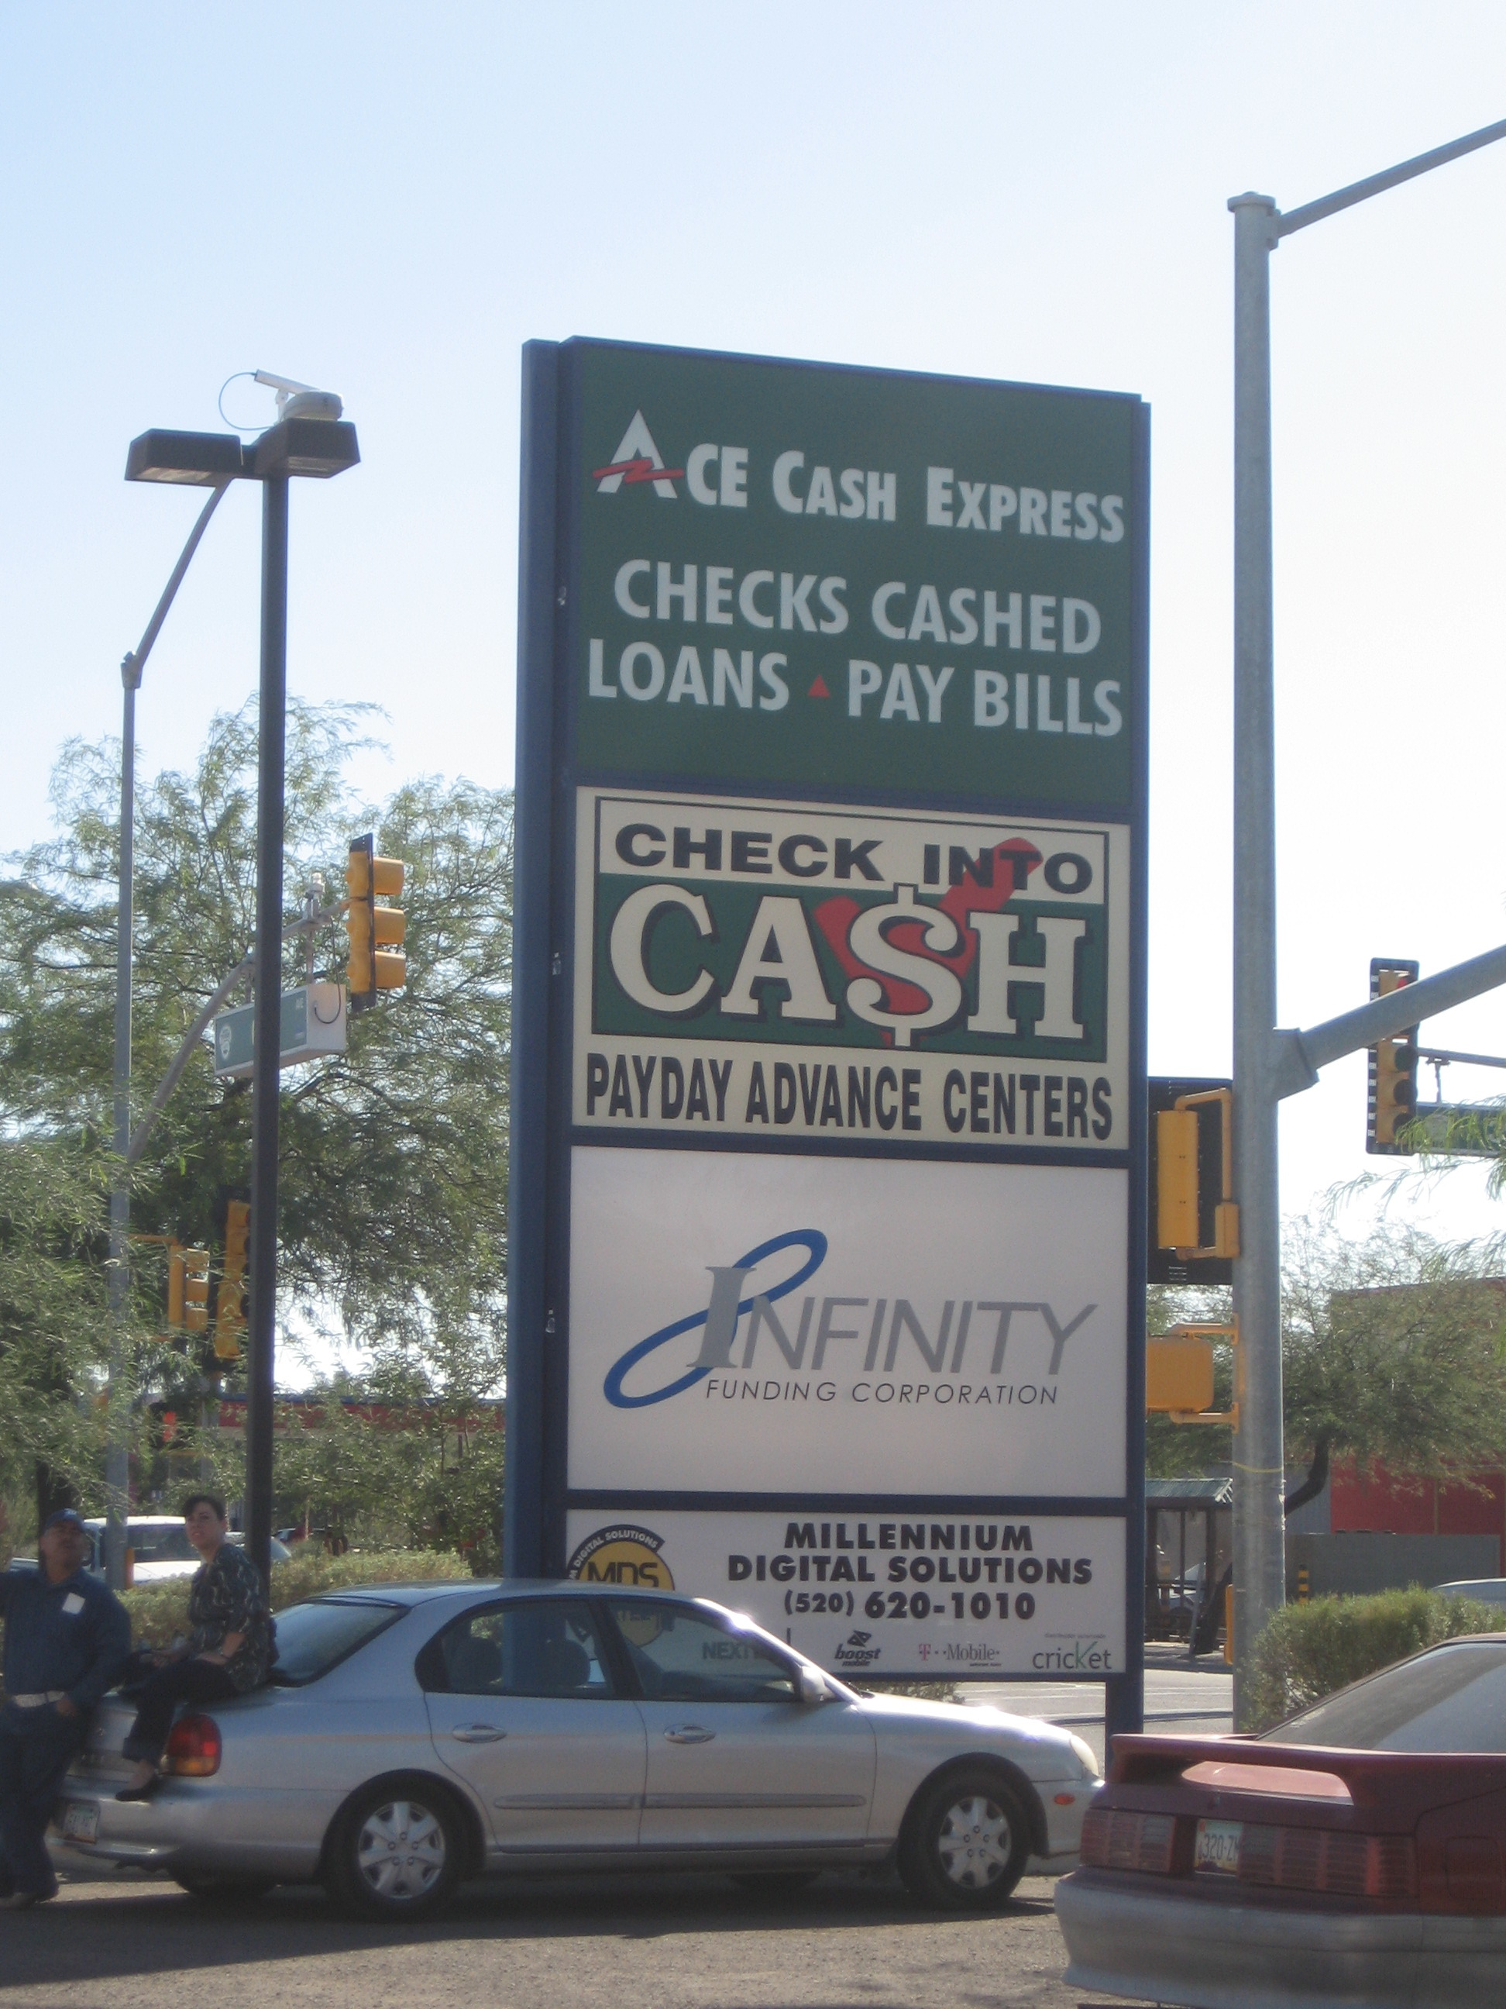
Check Cashing Business
Mathematics related to ratio, graphing, percents, multi-step calculation
How many Quick Cash Loans are there in our neighborhood?
How does this compare to the amount of banks present in this same area?
If you get a loan for $320.00, what will it cost to repay?

Slide 33
Pre-service Teacher Reflection
There was a lot more math within a few blocks of the school than I expected. It was also a good way to get to know the surrounding community. I liked the practice aspect of our investigations: using math to find out what the best deals are, what kind of bus pass to buy, how to win prizes at Peter Piper Pizza. … An interesting thing that happened while we were coming up with problems was we kept asking more and more questions. We only stopped because we ran out of room on the paper. We kept wondering, how many tickets? How many tokens? How many topping combinations? It goes on and on. Once we got going, we kept wondering more and more.
~ white pre-service bilingual teacher

Slide 34
Pre-service teacher reflection
An assignment that involves community tells the student that their community is important. It shows that we value where they come from and the community in which they live. It encourages students to become problem solvers within their community as well. Math is all about problem solving, and there is no community that doesn’t have problems. All communities could use problem solvers and this is one activity that encourages students to take ownership and leadership.”
~ African-American pre-service teacher

Slide 35
Beginning of Semester Survey
Questions Related to Funds of Knowledge:
Elementary teachers should support students understanding how mathematics can help them investigate their own lives.
1% Disagree/Strongly Disagree
99% Agree/Strongly Agree

Slide 36
The teacher can better support students’ development in math if s/he draws on their home/community resources.
6% Disagree/Strongly Disagree
94% Agree/Strongly Agree

Slide 37
In General
Very strong consensus on questions related to family and community-based funds of knowledge
Even at the beginning of the semester
Not true for questions related to children’s mathematical thinking
Could be related to nature of questions (easy to identify desired responses) or PSTs’ prior experiences, or PSTs’ greater willingness to accept ideas about funds of knowledge or…
Still not sure how to put these ideas into practice

Slide 38
Pre/Post Results - Questions Related to Children’s Mathematical Thinking
Children need to have many informal experiences solving simple word problems before they are expected to memorize number facts.
Pre-Survey: 59% Agree/Strongly Agree
Post-Survey: 65% Agree/Strongly Agree
It is the teacher’s job to demonstrate how to solve math problems the right way.
Pre-Survey: 43% Disagree/Strongly Disagree
Post-Survey: 55% Disagree/Strongly Disagree

Slide 39
Cautions
Results are preliminary; analyses are continuing
Still Unanswered:
What is the connection (for pre-service teachers) between children’s mathematical thinking and children’s family and community-based mathematical funds of knowledge?

Slide 40
For More Information…
http://mathconnect.hs.iastate.edu

